Slide 1
IT 305
Computer Networks
Spanning Tree and Debugging exercises

Slide 2
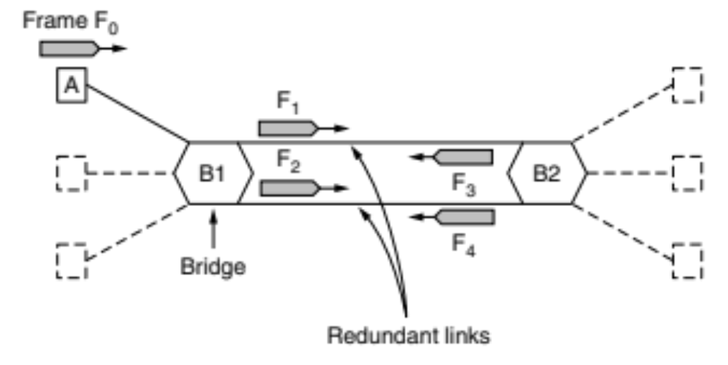
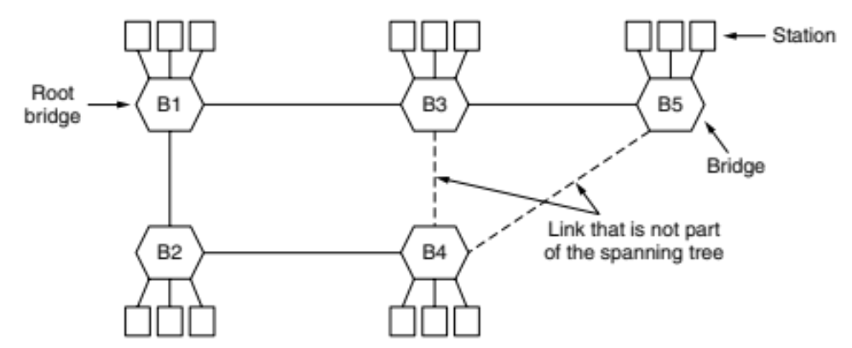
Spanning Tree - Invented by Radia Perlman
Overlay actual topology with spanning tree that reaches every switch
B1->B2; B1->B3 : One hop
B1->B4 (B2 or B3)
  Tie → Lowest identifier
    B2
B1->B3->B5
Only remember shortest path
Turn OFF ports otherwise

Slide 3
While troubleshooting a connectivity problem on the network, you issue the ping command from your PC command prompt, but the output shows "request times out." At which OSI layer is this problem associated with?
A. The data link layer
B. The application layer
C. The access layer
D. The session layer
E. The network layer

Slide 4
A host computer has been correctly configured with a static IP address, but the default gateway is incorrectly set. Which layer of the OSI model will be first affected by this configuration error?
A. Layer 1
B. Layer 2
C. Layer 3
D. Layer 4
E. Layer 5
F. Layer 6

Slide 5
A network administrator is connecting PC hosts A and B directly through their Ethernet interfaces as shown in the graphic. Ping attempts between the hosts are unsuccessful. What can be done to provide connectivity between the hosts?
IP: 192.1.1.201
SM: 255.255.255.240
IP: 192.1.1.20
SM: 255.255.255.240

Slide 6
There are 2 switches in the Testking LAN, with no routers. Ports 1, 2 & 3 are assigned to VLAN 1 in switch 1 and 2 and ports 4, 5 & 6 are assigned to VLAN 2 in both switches. These two switches are connected together via a trunked link. Which of the conditions below would verify trunk and VLAN operation?
A. Host 1 on VLAN 1 can ping Host 2 on VLAN 1
B. Host 1 on VLAN 1 can ping Host 4 on VLAN 2
C. Host 1 on VLAN 1 can not ping Host 2 on VLAN 1
D. Host 4 on VLAN 2 can not ping Host 1 on VLAN 1
E. Host 4 on VLAN 2 can ping Host 2 on VLAN 2

Slide 7
There are 2 switches in the Testking LAN, with no routers. Ports 1, 2 & 3 are assigned to VLAN 1 in switch 1 and 2 and ports 4, 5 & 6 are assigned to VLAN 2 in both switches. These two switches are connected together via a trunked link. Which of the conditions below would verify trunk and VLAN operation?
A. Host 1 on VLAN 1 can ping Host 2 on VLAN 1
B. Host 1 on VLAN 1 can ping Host 4 on VLAN 2
C. Host 1 on VLAN 1 can not ping Host 2 on VLAN 1
D. Host 4 on VLAN 2 can not ping Host 1 on VLAN 1
E. Host 4 on VLAN 2 can ping Host 2 on VLAN 2
If there is no router present, only hosts in the same VLAN will be able to ping each other. In order for any host on one VLAN to communicate with a host on another VLAN, the traffic must pass through a router. Host within the same VLAN will be able to ping each other, even though they reside on different switches, as long as the switches have a trunk connection configured between them.

Slide 8
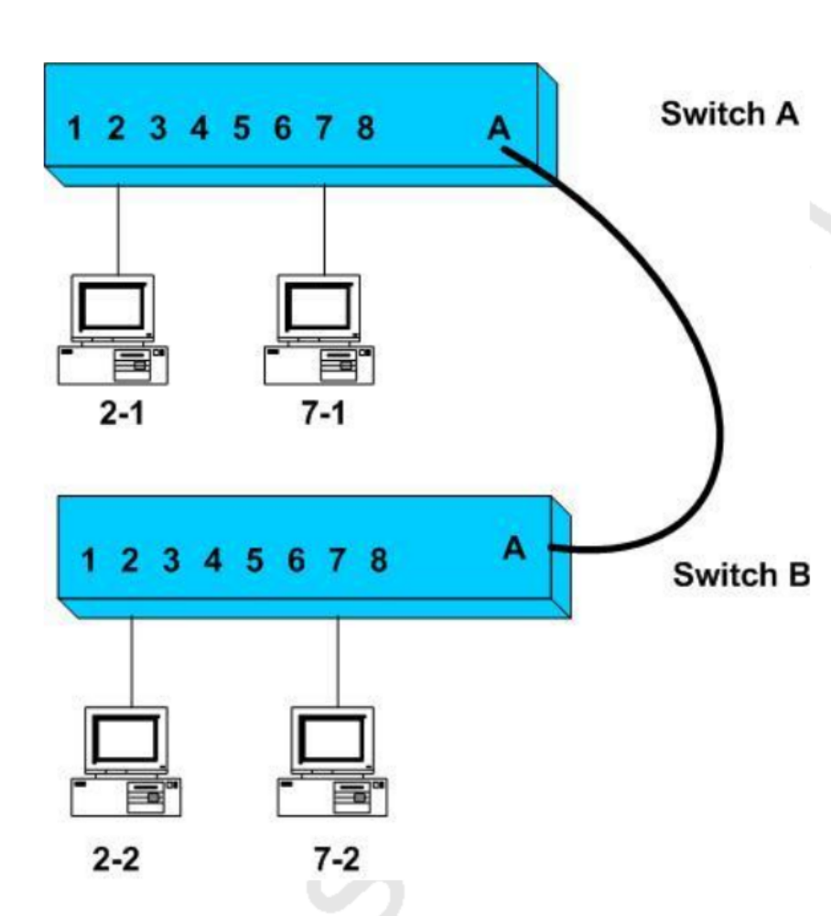
Ports 1 through 4 on each switch are assigned to VLAN1
Ports 5 through 8 on each switch are assigned to VLAN2.
An ISL trunk link connects the two switches.
Which of the following are True?
Host 2-1 can ping Host 2-2
Host 2-1 can ping Host 7-2
Host 2-1 can not ping Host 2-2
Host 7-1 can not ping Host 2-2
Host 7-1 can ping Host 7-2

Slide 9
Ports 1 through 4 on each switch are assigned to VLAN1
Ports 5 through 8 on each switch are assigned to VLAN2.
An ISL trunk link connects the two switches.
Which of the following are True?
Host 2-1 can ping Host 2-2
Host 2-1 can ping Host 7-2
Host 2-1 can not ping Host 2-2
Host 7-1 can not ping Host 2-2
Host 7-1 can ping Host 7-2

